Slide 1
Scrum in NNG

Slide 2
Agenda
What – Project is for
Why – using Agile/Scrum in Project
Where – to mange Backlog
When - to catch up
How – to successfully deliver

Slide 3
What Project is for?

Slide 4
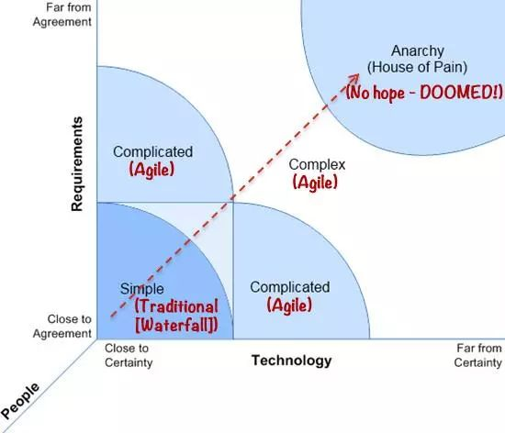
Why use Agile/Scrum
Requirement(2/5)
Ensure service contingency on services
New Features on Functions & Security
Upgraded upstream APIs
Technology(3/5)
New framework with Reactor
Micro-Services
Infrastructure & Network
Values
Individuals and interactions over processes and tools
Working software over comprehensive documentation
Customer collaboration over contract negotiation
Responding to changes over following a plan

Slide 5
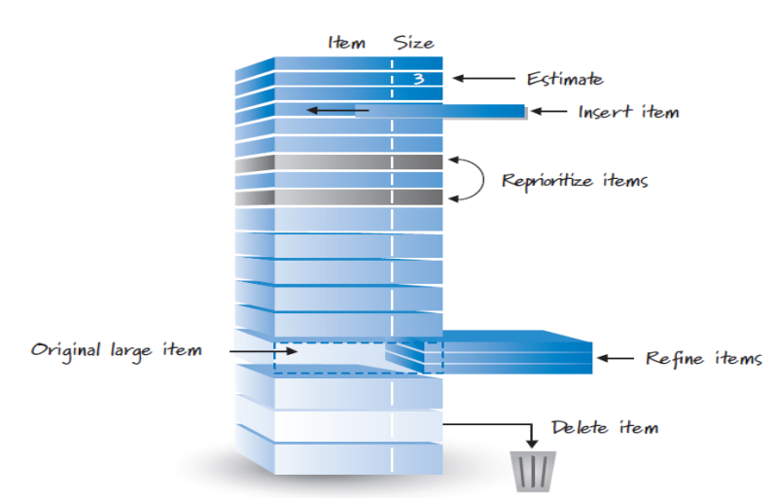
Where to manage Backlog
A healthy backlog must be DEEP:
Detailed appropriately
Estimated
Emergent
Prioritized
Structure Diagram(Requirements, Story-Creation)

Slide 6
When to catch up
Planning
Selection and define sprint goal
Decide how to achieve goal
Decompose Backlog
Daily Standup: Not a status checkup meeting; but team members making commitments in front of peers
What did I get DONE yesterday?
What will I get DONE today?
Are there any impediments blocking me?
Retro & Respective
presents what is accomplished (DONE) during the sprint
Continuous improvements
Duration: 3 weeks
Requirement Change: Add Only
Bandwidth: Partial
Urgency: Medium
<<Diagram of deliveries & points in every sprint>>

Slide 7
How to evaluate deliveries
Test Driven Development
Test automation & Mock Local Tests
Code Review
CI & CD

Slide 8
How to avoid possible risks
Bandwidth
Calculate & adjust story points to deliver before planning meeting
Change the duration of Sprint with actual project situation
Difficulty of dividing some of the stories into smaller pieces
Split into something which are testable & deliverable
Stories’ scope varies in the progress of sprint
Make a preliminary risk estimate in planning meeting
Identify stories which the uncertainty is high and break down into smaller stories.
Put low priority stories without much dependencies into next sprint
Communication with Domain
Reach the agreement for Sprint Deliverable in the beginning
Present report upon each sprint completion

Slide 9
Q&A

